Slide 1
Week 1

Slide 2
Note to Teacher:
Students will use an inch ruler and a centimeter ruler for this week's Math Corner. It is essential for students to experience measurement concretely in order to gain understanding.

Slide 3

Math Corner
Using a ruler, measure your pencil to the nearest inch. Draw a picture of your findings.

Slide 4
Math Corner-
Refer to the paper clip and pencil below. About how many paper clips long is the pencil? Measure your pencil in inches and centimeters.
What do you notice about your measurements?

Slide 5
Math Corner
Using your ruler, tell how many CENTIMETERS, and compare your measurements with a neighbor.
Dry erase marker
A Rekenrek
**How are inches and centimeters alike and different?

Slide 6
Math Corner
Using a tape measure, tell how many CENTIMETERS, and compare your measurements with a neighbor.
The width of your desk
The height your chair
Tell how many centimeters the two objects are combined.
What is the difference between the measurements of the two objects?

Slide 7
Math Corner
Estimate the length of each object and measure it. Create and fill in the chart below.
Challenge!
Name something that you would measure using:
Centimeters or inches
Meters or yards
Kilometers or Miles
Object | Write Your Estimate With a Marker | Actual Length
Crayon
Dry erase marker
Math Journal

Slide 8
Week 2

Slide 9
Math Corner
From your seat, complete the scavenger hunt below. Make a table to record your estimate, then measure your items. Use a ruler to help you estimate.
Name 2 items in your class that are about 2 inches long.
Name 2 items in your classroom that are about 6 inches long.
Name 2 items in your classroom that are about 10 inches long.

Slide 10
Math Corner
Using your ruler, tell how many INCHES, and compare your measurements with a neighbor.
The height of your math journal
The height of a playing card
Tell how many inches the two objects are combined.
How much taller is your math journal than a card?

Slide 11
Math Corner
From your seat, complete the scavenger hunt below. Make a table to record your estimate, then measure your items. Use a ruler to help you estimate.
Name 2 items in your class that is about 1 cm long.
Name 2 items in your classroom that are about 20 cm long.
Name 2 items in your classroom that are about 50 cm long.

Slide 12

Math Corner
Juanita decides the tail on her kite is too long. She cuts off 11 feet. Now the kite tail 39 feet long. How long was the kite before Juanita cut it?
What strategy helps you to prove your thinking?

Slide 13
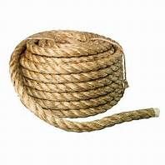
Math Corner
Thomas has a thick piece of rope. He gave his brother 25 feet. Now he has 50 feet left. How much rope did Thomas have to start with?
Explain your reasoning with pictures, numbers, or words.

Slide 14
Week 3

Slide 15
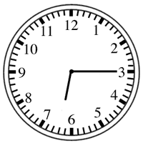
Math Corner
Look at the clock.
What time is it now?
Dinner will be ready in five minutes. What time will dinner be ready?
You have to go to bed in 3 hours. What time will it be then?

Slide 16
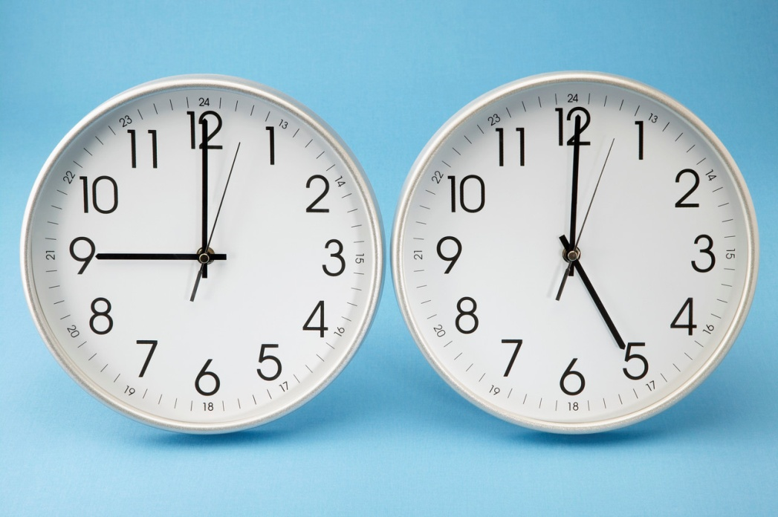
Math Corner
Look at the two clocks and answer the questions below.
What time is it on clock A? Draw a clock with this time. What are you normally doing on a Tuesday morning at this time?
What time is it on clock B? Draw a clock with this time. What are you normally doing on a Thursday afternoon at this time?
CLOCK A
CLOCK B

Slide 17
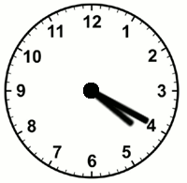

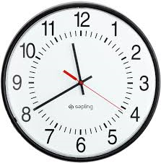
Math Corner-Thursday
What strategies can I use to help me tell time?
Tell the time on the clocks below.
What time will it be on each clock 10 minutes later?
Clock A Clock B Clock C

Slide 18
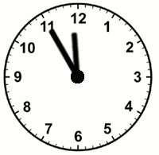
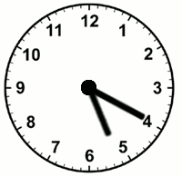
Math Corner-Monday
Tell the time. Name something that you normally do at the times below.
Think Space!
The problem is 29 + 29 + 29. Solve it as many different ways as you can using MENTAL MATH ONLY.

Slide 19
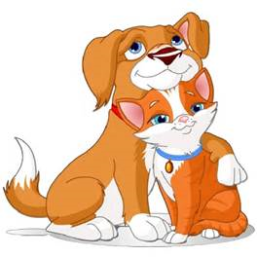
Math Corner
My dog is 46 inches. My cat is 28 inches smaller than my dog. How tall is my cat?
Prove your thinking using 2 different strategies.

Slide 20
Bonus Slides

Slide 21


Math Corner
A building is 60 meters tall. A tree near the building is 12 meters tall. How much taller is the building than the tree?
Prove your thinking by using 2 strategies.

Slide 22
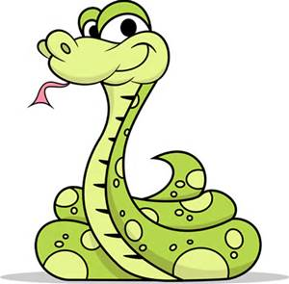
Math Corner
A snake was 35 inches long. Now, it’s 87 inches long.
How much did the snake grow?
Solve using 2 different strategies.

Slide 23
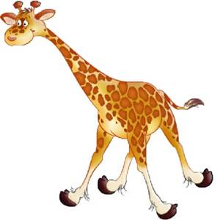
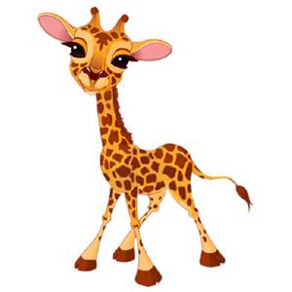
Math Corner
A baby giraffe was 36 cm tall. Another young giraffe was 100 cm tall. How much shorter is the baby giraffe?
Use 2 different strategies to prove your thinking.

Slide 24
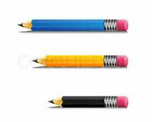
Math Corner
I have 3 pencils. The lengths are 17 inches, 19 inches, and 13 inches. What is the total length of all 3 pencils?
Solve using a number line, then solve using a place value strategy.

Slide 25
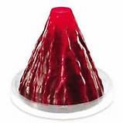
Math Corner
It takes 27 large paperclips to measure a model volcano. It takes twice as many to measure the volcano with unifix cubes. How many unifix cubes did it take to measure the volcano?

Slide 26
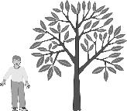
Math Corner
Look at the picture of Devin standing next to a tree. Devin is 3 feet tall. About how tall is the tree?

